Slide 1
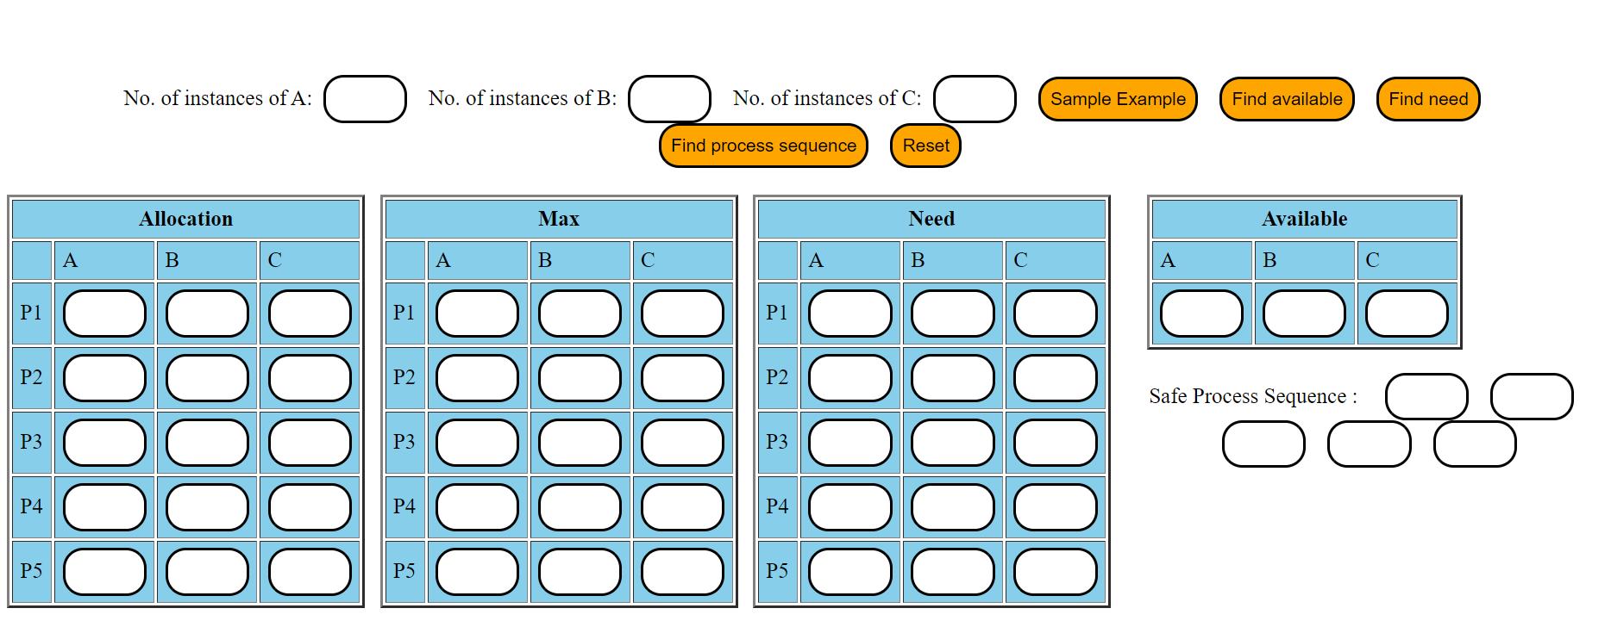
https://jangidbhanu.github.io/BankersAlgorithm/

Slide 2
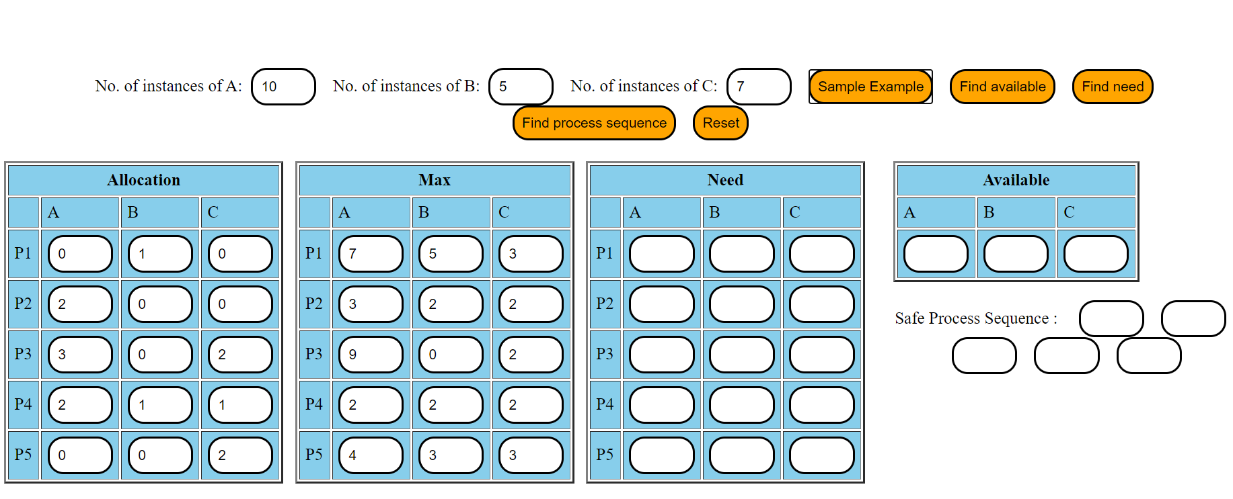

Slide 3
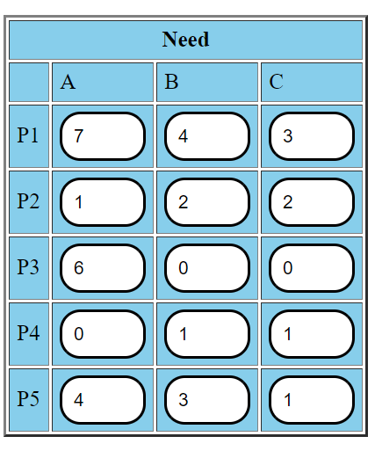
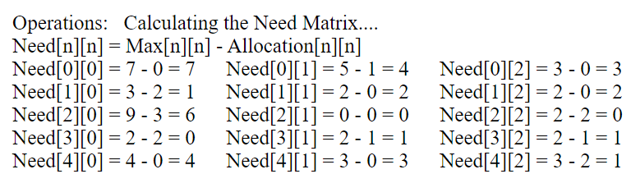

Slide 4
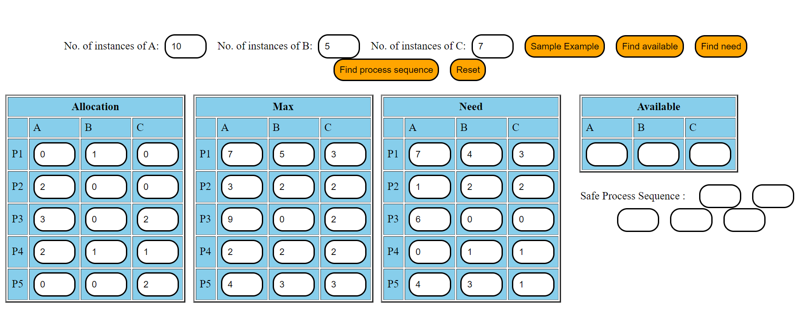

Slide 5
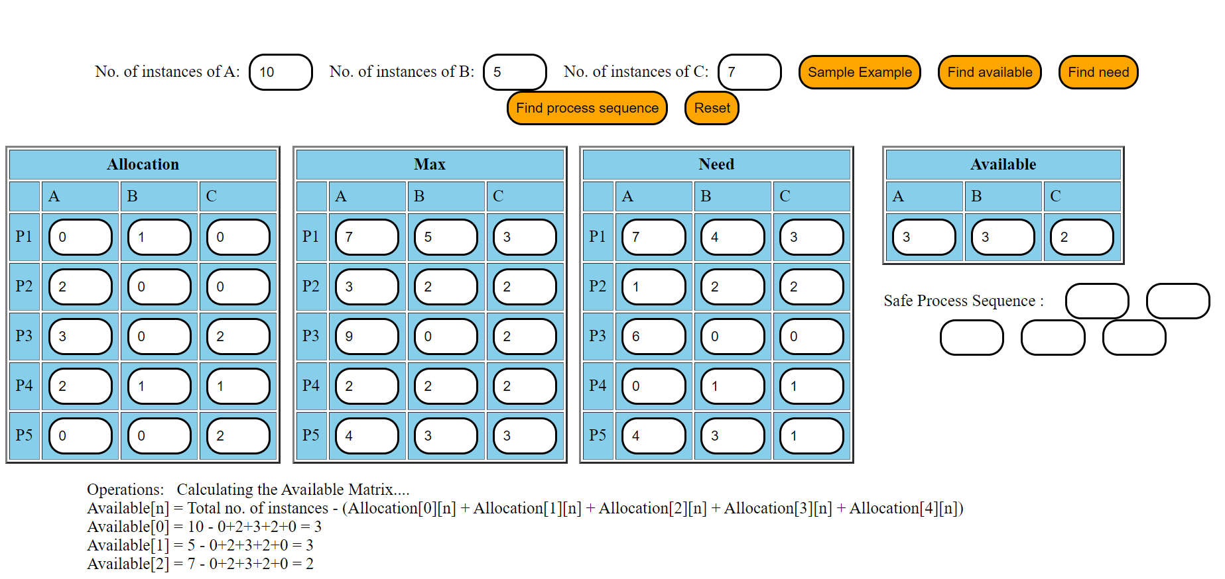

Slide 7


P2
P4
P5
P1

Slide 8

P2
P4
P5
P1
P3

